Slide 1
How Not to Be Wrong
Robert Gebeloff
Dataharvest 2017

Slide 2

How Not to Be Wrong*
* My apologies… somebody used my title first...
Robert Gebeloff | @gebeloffnyt | Dataharvest 2017

Slide 3
How Not to Be Wrong*
So I selected the topic of this talk after a lot of thinking….
Robert Gebeloff | @gebeloffnyt | Dataharvest 2017

Slide 4

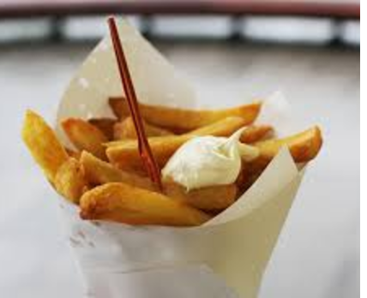
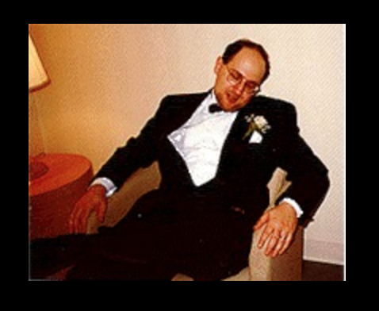
How Not to Be Wrong*
??????
Robert Gebeloff | @gebeloffnyt | Dataharvest 2017

Slide 5
How Not to Be Wrong*
But before I begin, I should probably answer the question my mother always asks…
Robert Gebeloff | @gebeloffnyt | Dataharvest 2017

Slide 6

How Not to Be Wrong*
What is it that you actually DO for a living?
Robert Gebeloff | @gebeloffnyt | Dataharvest 2017

Slide 7
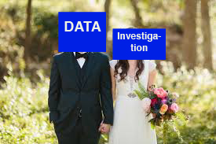
LAST YEAR’S INTRO…

Slide 8
Marrying Data And Investigative Journalism Techniques
Who Am I?
Journalist with 28 years of professional experience
Very traditional U.S. reporting background
Always incorporated data in my work, specialized in data journalism starting in 1997
Robert Gebeloff -- @gebeloffnyt- DATAHARVEST 2016

Slide 9
Marrying Data And Investigative Journalism Techniques
My Approach to Stories
Data journalism is not magic, it’s just another form of journalism
For all stories, we need sources:
Robert Gebeloff -- @gebeloffnyt- DATAHARVEST 2016

Slide 10
Marrying Data And Investigative Journalism Techniques
My Approach to Stories
Observation – what you see is as important as anything… set the scene, jot down details, hear, smell, count, etc.
Robert Gebeloff -- @gebeloffnyt- DATAHARVEST 2016

Slide 11
Marrying Data And Investigative Journalism Techniques
My Approach to Stories
People – finding people who know the info, getting them to tell you the info you need
Robert Gebeloff -- @gebeloffnyt- DATAHARVEST 2016

Slide 12
Marrying Data And Investigative Journalism Techniques
My Approach to Stories
Documents – Paper can be better than people – facts in black and white – court records, audits, LEAKS, etc. Your eyes can deceive you, people can lie to you, but docs are docs...
Robert Gebeloff -- @gebeloffnyt- DATAHARVEST 2016

Slide 13
Marrying Data And Investigative Journalism Techniques
My Approach to Stories
Data – Numeric information that isn’t in narrative form; raw information that hasn’t been summarized or otherwise processed – journalists become social scientists, find the news
Robert Gebeloff -- @gebeloffnyt- DATAHARVEST 2016

Slide 14
How Not to Be Wrong*
Getting back to my thinking…
Robert Gebeloff | @gebeloffnyt | Dataharvest 2017

Slide 15
How Not to Be Wrong*
When i work on a big story, i want to know everything about the topic. From a data perspective, this means
Robert Gebeloff | @gebeloffnyt | Dataharvest 2017

Slide 16
How Not to Be Wrong*
A) Getting all relevant data sources
Robert Gebeloff | @gebeloffnyt | Dataharvest 2017

Slide 17
How Not to Be Wrong*
Getting all relevant data sources
Examining the data in all relevant ways
Robert Gebeloff | @gebeloffnyt | Dataharvest 2017

Slide 18
How Not to Be Wrong*
Getting all relevant data sources
Examining the data in all relevant ways
Publishing something we believe to be true
Robert Gebeloff | @gebeloffnyt | Dataharvest 2017

Slide 19
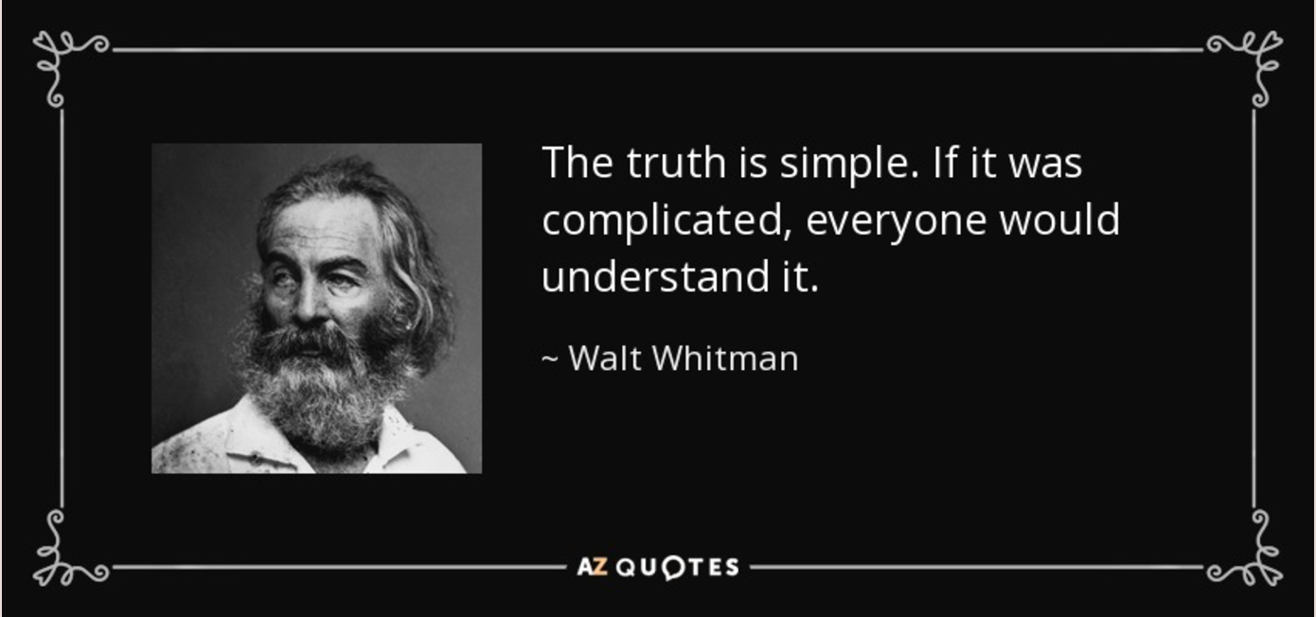
How Not to Be Wrong*
Robert Gebeloff | @gebeloffnyt | Dataharvest 2017

Slide 20
How Not to Be Wrong*
Not sure that’s actually relevant, just mind-blowing…
Anyway, what I want to talk about is a danger often hidden at the intersection of data and journalism...
Robert Gebeloff | @gebeloffnyt | Dataharvest 2017

Slide 21

How Not to Be Wrong*
Data
Journalism
Robert Gebeloff | @gebeloffnyt | Dataharvest 2017

Slide 22
How Not to Be Wrong*
After much more thinking...
Robert Gebeloff | @gebeloffnyt | Dataharvest 2017

Slide 23
How Not to Be Wrong*
What should I call this aforementioned danger?
Robert Gebeloff | @gebeloffnyt | Dataharvest 2017

Slide 24
How Not to Be Wrong*
I came up with this moniker:
TRUE!
But…
Wrong!
Robert Gebeloff | @gebeloffnyt | Dataharvest 2017

Slide 25

How Not to Be Wrong*
Evidence →
Evidence →
Robert Gebeloff | @gebeloffnyt | Dataharvest 2017
Evidence →

Slide 26
How Not to Be Wrong*
2+2 =4
Robert Gebeloff | @gebeloffnyt | Dataharvest 2017

Slide 27

How Not to Be Wrong*
2+2 =4
+
Robert Gebeloff | @gebeloffnyt | Dataharvest 2017

Slide 28
How Not to Be Wrong*
2+2 != 5
1
2
+
3
4
Robert Gebeloff | @gebeloffnyt | Dataharvest 2017

Slide 29
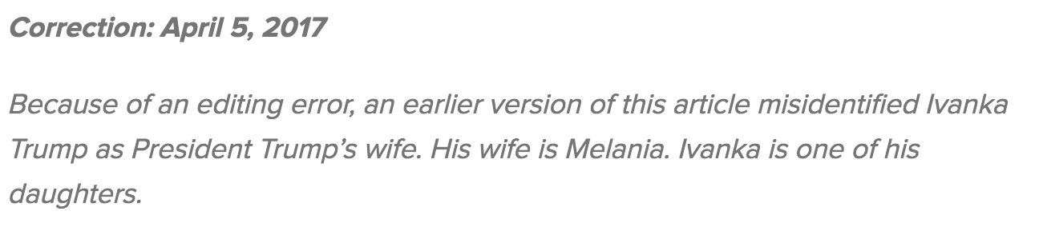
How Not to Be Wrong*
Robert Gebeloff | @gebeloffnyt | Dataharvest 2017

Slide 30
How Not to Be Wrong*
In assessing the truthfulness of statements, various fact-checking regimes have invented “scales”, from false to true and everything in between…
Robert Gebeloff | @gebeloffnyt | Dataharvest 2017

Slide 31
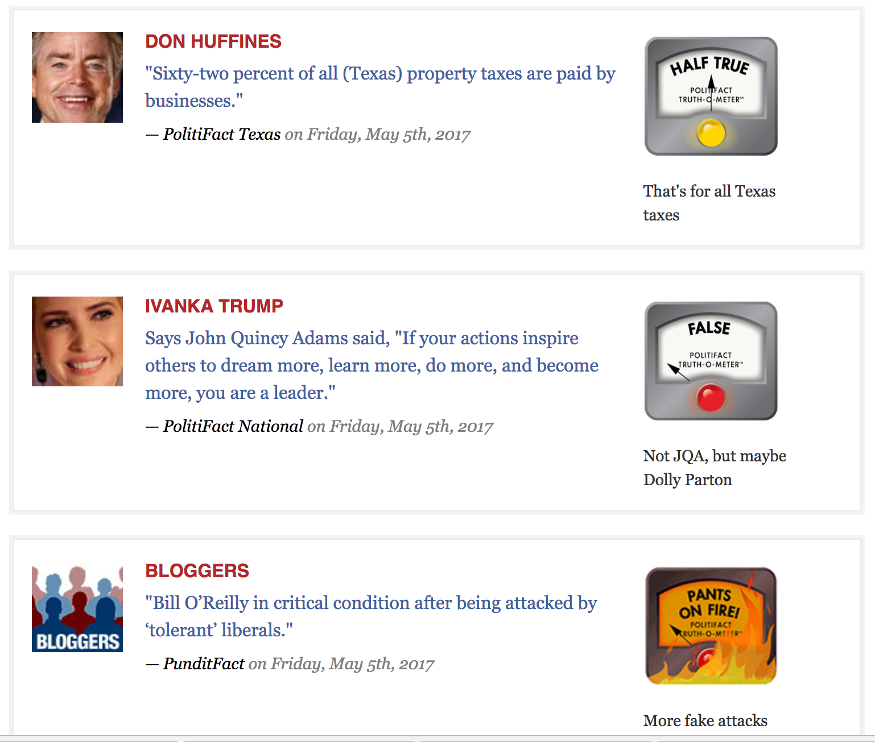
How Not to Be Wrong*
Robert Gebeloff | @gebeloffnyt | Dataharvest 2017

Slide 32
How Not to Be Wrong*
But in data journalism, we cannot settle for “half-true”, partially-true, etc. Anything short of true is wrong – and we cannot afford to be wrong.
Robert Gebeloff | @gebeloffnyt | Dataharvest 2017

Slide 33
How Not to Be Wrong*
You can do the math correctly, but get the context wrong.Or not describe your findings correctly. Or fail to acknowledge any uncertainties involved in your findings.
Robert Gebeloff | @gebeloffnyt | Dataharvest 2017

Slide 34
How Not to Be Wrong*
HOUSEHOLD COMPOSITION
Year: | 1990 | 2000
Households | 600 | 650
Married W/Kids | 400 | 405
Single Mom | 50 | 45
Single Dad | 2 | 5
Other | 149 | 195
Married W/Kids | 66.7% | 62.3%
Single Mom | 8.3% | 6.9%
Single Dad | 0.3% | 0.8%
Non-Family | 24.8% | 30.0%
Robert Gebeloff | @gebeloffnyt | Dataharvest 2017

Slide 35
How Not to Be Wrong*
HOUSEHOLD COMPOSITION
Year: | 1990 | 2000
Households | 600 | 650
Married W/Kids | 400 | 405
Single Mom | 50 | 45
Single Dad | 2 | 5
Other | 149 | 195
Married W/Kids | 66.7% | 62.3%
Single Mom | 8.3% | 6.9%
Single Dad | 0.3% | 0.8%
Non-Family | 24.8% | 30.0%
Robert Gebeloff | @gebeloffnyt | Dataharvest 2017

Slide 36
How Not to Be Wrong*
HOUSEHOLD COMPOSITION
Year: | 1990 | 2000
Households | 600 | 650 | 8%
Married W/Kids | 400 | 405 | 1%
Single Mom | 50 | 45 | -10%
Single Dad | 2 | 5 | 150%
Other | 149 | 195 | 31%
Robert Gebeloff | @gebeloffnyt | Dataharvest 2017

Slide 37
How Not to Be Wrong*
New York Times Asylum Story
Robert Gebeloff | @gebeloffnyt | Dataharvest 2017

Slide 38
How Not to Be Wrong*
New York Times Asylum Story
A story was slated for the front page reporting that asylum judges appointed by Bush under political litmus test were far more likely to reject asylum seekers
Robert Gebeloff | @gebeloffnyt | Dataharvest 2017

Slide 39
How Not to Be Wrong*
New York Times Asylum Story
Evidence: Outcome data for all asylum judges, including the 16 appointed with political considerations
Robert Gebeloff | @gebeloffnyt | Dataharvest 2017

Slide 40
Robert Gebeloff | @gebeloffnyt | Dataharvest 2017

Slide 41
How Not to Be Wrong*
Can anybody see a problem with our thesis?
Robert Gebeloff | @gebeloffnyt | Dataharvest 2017

Slide 42
How Not to Be Wrong*
Can anybody see a problem with our thesis?
The original premise was based on the fact that 11 (or 12, depending on how we counted) of the judges said “no” at a higher rate than peers…
Robert Gebeloff | @gebeloffnyt | Dataharvest 2017

Slide 43
How Not to Be Wrong*
Can anybody see a problem with our thesis?
But while that’s true, how many of the judges had a statistically significant difference from peers?
And what about all the other judges appointed before Bush – our subjects might be above average in stringency, but where do they actually rank?
Robert Gebeloff | @gebeloffnyt | Dataharvest 2017

Slide 44
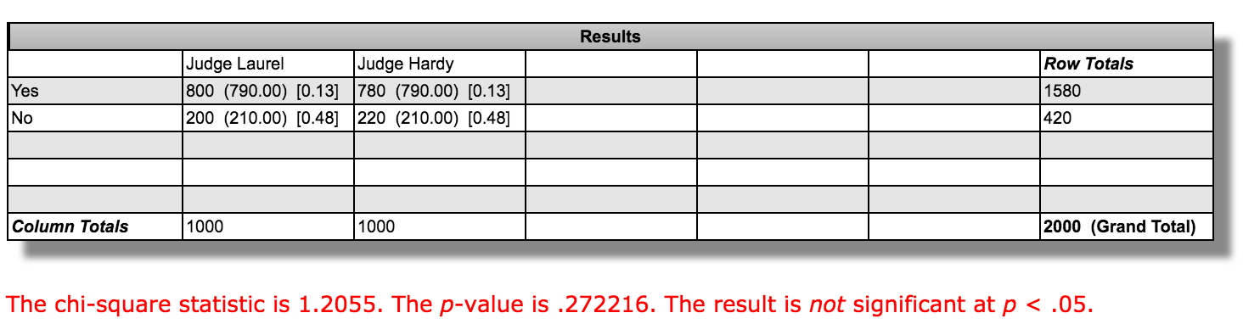
How Not to Be Wrong*
Statistical significance is often calculated using a Chi Square formula, which you can find in various free online calculators and spreadsheet templates.
Robert Gebeloff | @gebeloffnyt | Dataharvest 2017

Slide 45
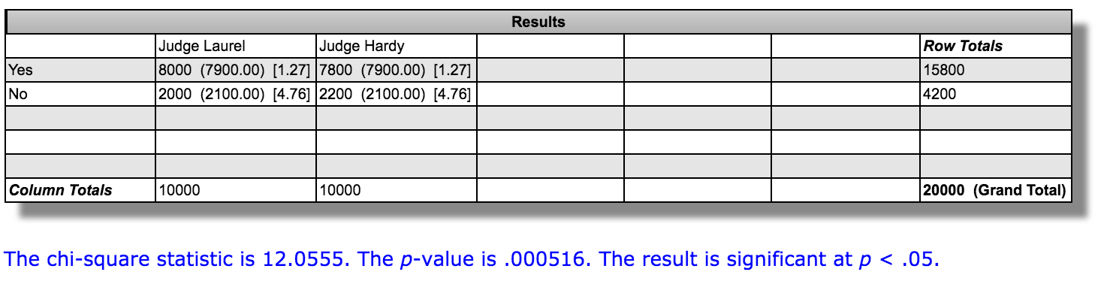
How Not to Be Wrong*
The formula accounts for the difference, but also the sample size. So in this example, 80% vs 78% -- the difference is statistically significant at a larger sample size.
Robert Gebeloff | @gebeloffnyt | Dataharvest 2017

Slide 46
How Not to Be Wrong*
“I think we need to be careful to make this point in the proper context and with appropriate caveats. More specifically, while our judges are tougher than average on people who apply for asylum, there are plenty of judges who have higher relative denial rates than our folks….”
Robert Gebeloff | @gebeloffnyt | Dataharvest 2017

Slide 47
How Not to Be Wrong*
Only two of our 16 rank among the 50 judges with the highest relative denial rates. Six of our judges fall into place between 57 and 80 in the rankings, which is still well above average but not near the top.
Robert Gebeloff | @gebeloffnyt | Dataharvest 2017

Slide 48
How Not to Be Wrong*
Also I think we’re going to have to ditch the 11 of 16 being above average as our best number – two of the 11 have differences that are not statistically significant, so I think it opens us up for criticism if we try to portray them as above average.
Robert Gebeloff | @gebeloffnyt | Dataharvest 2017

Slide 49
How Not to Be Wrong*
And finally he gets to the point….
In my opinion, this becomes more of a journalistic decision than a statistical one.
Robert Gebeloff | @gebeloffnyt | Dataharvest 2017

Slide 50
How Not to Be Wrong*
Fancy Math….
.
vs
Standard Math
Robert Gebeloff | @gebeloffnyt | Dataharvest 2017

Slide 51
How Not to Be Wrong*
Fancy Math….
.
More is possible, can explore complex relationships, but: Harder to execute, harder to explain…
Robert Gebeloff | @gebeloffnyt | Dataharvest 2017

Slide 52
How Not to Be Wrong*
Data summarized, but doesn’t account for complex relationships; Easier to execute and explain..
.
Standard Math
Robert Gebeloff | @gebeloffnyt | Dataharvest 2017

Slide 53
Behind The Boom
Many stories about the economic benefits of the North Dakota oil boom
Robert Gebeloff -- @gebeloffnyt--NICAR 2015

Slide 54
Behind The Boom
Many stories about the economic benefits of the North Dakota oil boom
Fewer stories about the environmental issues, and those usually about individual spills or incomplete.
Robert Gebeloff -- @gebeloffnyt--NICAR 2015

Slide 55
Behind The Boom
Many stories about the economic benefits of the North Dakota oil boom
Fewer stories about the environmental issues, and those usually about individual spills or incomplete.
Times sends correspondent to size up the situation, hoping for quick turnaround story.
Robert Gebeloff -- @gebeloffnyt--NICAR 2015

Slide 56
Behind The Boom
Many stories about the economic benefits of the North Dakota oil boom
Fewer stories about the environmental issues, and those usually about individual spills or incomplete.
Times sends correspondent to size up the situation, hoping for quick turnaround story.
Once she realizes extent of the issue, and how difficult it will be to document, a project is born.
Robert Gebeloff -- @gebeloffnyt--NICAR 2015

Slide 57
Behind The Boom
There were no official stats on oil spills — the Feds regulate pipelines, everything else is left to the states.
Robert Gebeloff -- @gebeloffnyt--NICAR 2015

Slide 58
Behind The Boom
There were no official stats on oil spills — the Feds regulate pipelines, everything else is left to the states.
North Dakota has lots of public info on oil production, but it’s mostly in PDFs
Robert Gebeloff -- @gebeloffnyt--NICAR 2015

Slide 59
Behind The Boom
There were no official stats on oil spills — the Feds regulate pipelines, everything else is left to the states.
North Dakota has lots of public info on oil production, but it’s mostly in PDFs
Spills were recently posted online, but the format isn’t very analyze-able– it’s not searchable, you have to read incidents one at a time.
Robert Gebeloff -- @gebeloffnyt--NICAR 2015

Slide 60
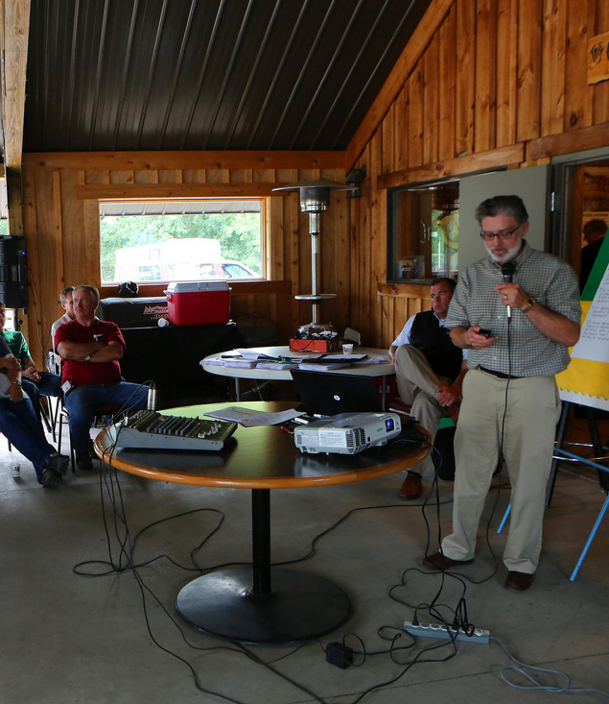
Behind The Boom
Over the summer, speaking to farmers in the town of Antler, Lynn D. Helms, the director of the Department of Mineral Resources, announced “a little bit of good news”: The spill rate per well was “steady or down.”
Robert Gebeloff -- @gebeloffnyt--NICAR 2015

Slide 61
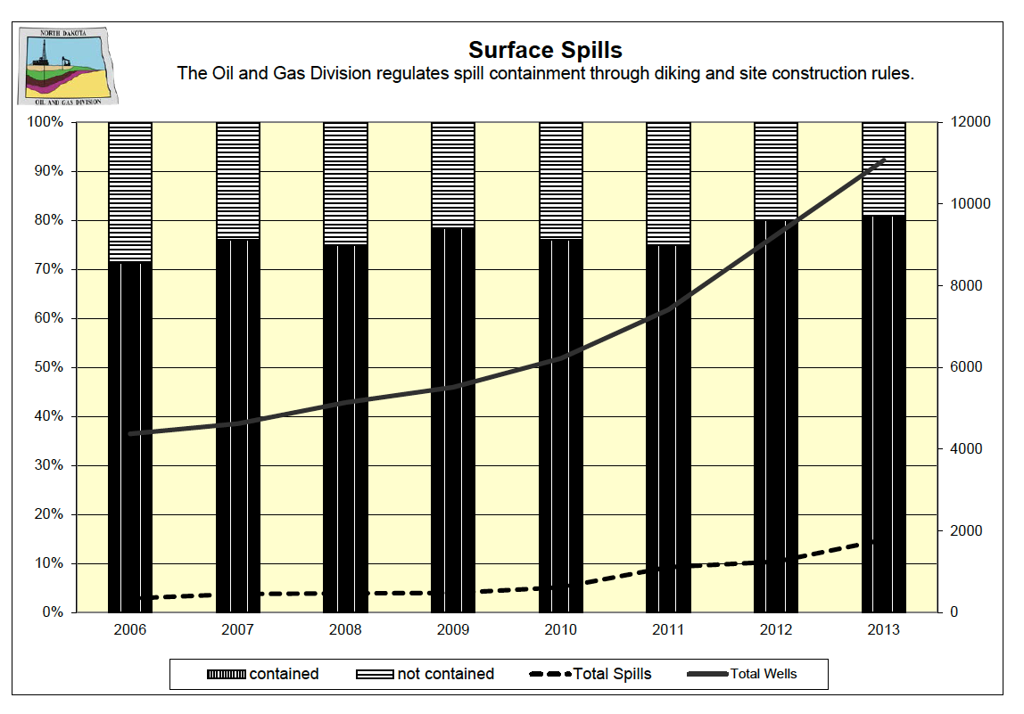
Behind The Boom
Robert Gebeloff -- @gebeloffnyt--NICAR 2015

Slide 62
Behind The Boom
Creating Our Own Database
1) Downloading the incident records required a scraper. In this case we used a browser emulator to go through the site and download the pages
Robert Gebeloff -- @gebeloffnyt--NICAR 2015

Slide 63
Behind The Boom
Creating Our Own Database
1) Downloading the incident records required a scraper. In this case we used a browser emulator to go through the site and download the pages
browser = Watir::Browser.new :firefox
browser.goto 'http://www.ndhealth.gov/ehs/foia/spills/defaultOGContained.aspx’
opening_page = Nokogiri::HTML.parse(browser.html)
Robert Gebeloff -- @gebeloffnyt--NICAR 2015

Slide 64
Behind The Boom
Creating Our Own Database
2) Cleaning up the mess — standardizing company names, incident types, correcting errors — initial report said zero spilled, but full text of incident said something else.
Robert Gebeloff -- @gebeloffnyt--NICAR 2015

Slide 65
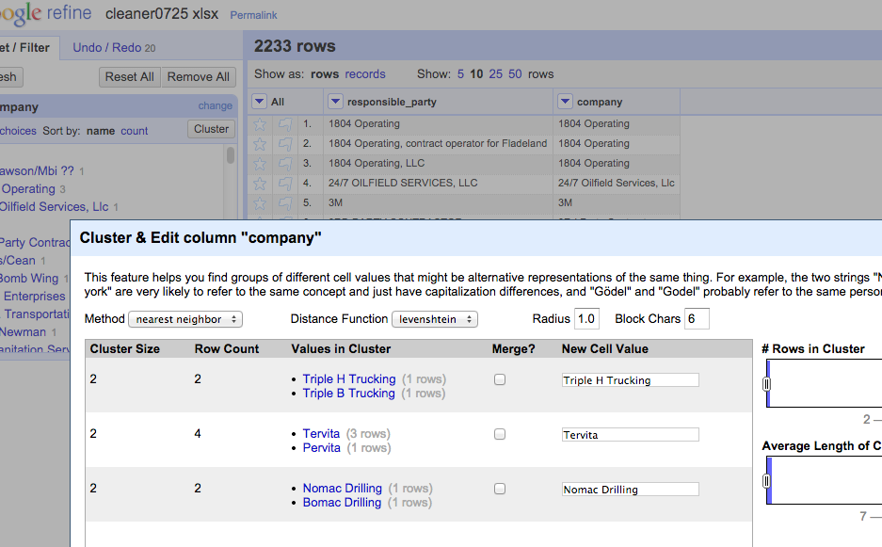
Behind The Boom
Creating Our Own Database
Robert Gebeloff -- @gebeloffnyt--NICAR 2015

Slide 66
Behind The Boom
Creating Our Own Production Data
2) Downloading monthly PDF files — able to use WGET all for this, then Monarch to parse the info
We built a list of report URLS in Excel for WGET:
https://www.dmr.nd.gov/oilgas/mpr/2006_09.pdf
https://www.dmr.nd.gov/oilgas/mpr/2006_10.pdf
https://www.dmr.nd.gov/oilgas/mpr/2006_11.pdf
https://www.dmr.nd.gov/oilgas/mpr/2006_12.pdf
https://www.dmr.nd.gov/oilgas/mpr/2007_01.pdf
https://www.dmr.nd.gov/oilgas/mpr/2007_02.pdf
https://www.dmr.nd.gov/oilgas/mpr/2007_03.pdf
https://www.dmr.nd.gov/oilgas/mpr/2007_04.pdf
Robert Gebeloff -- @gebeloffnyt--NICAR 2015

Slide 67
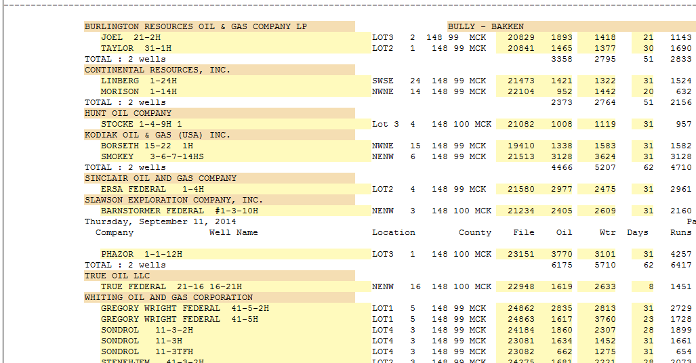
Behind The Boom
Creating Our Own Production Data
Robert Gebeloff -- @gebeloffnyt--NICAR 2015

Slide 68
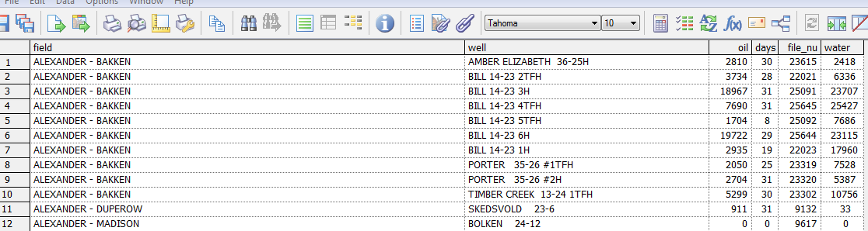
Behind The Boom
Creating Our Own Production Data
Robert Gebeloff -- @gebeloffnyt--NICAR 2015

Slide 69
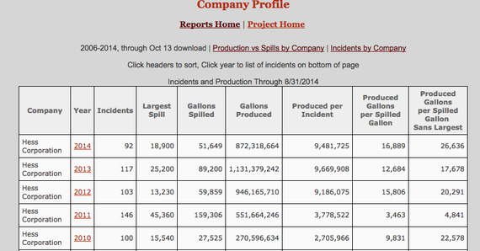
Behind The Boom
Putting It All Together
Robert Gebeloff -- @gebeloffnyt--NICAR 2015

Slide 70
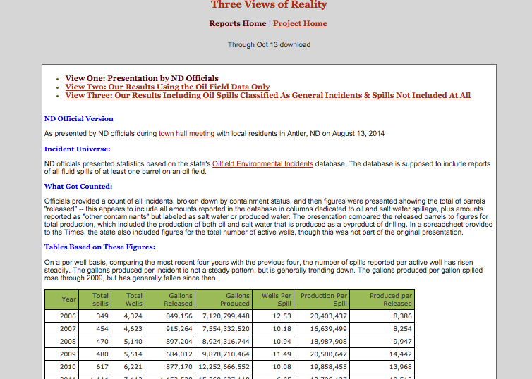
Behind The Boom
Putting It All Together
Robert Gebeloff -- @gebeloffnyt--NICAR 2015

Slide 71
Behind The Boom
Robert Gebeloff -- @gebeloffnyt--NICAR 2015

Slide 72
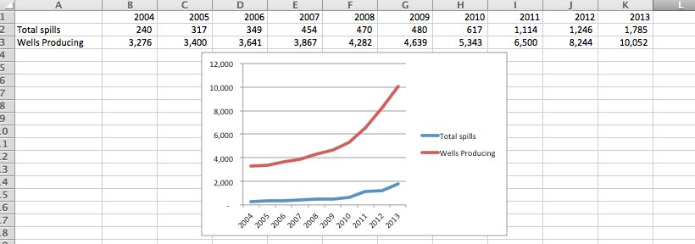
Behind The Boom
Robert Gebeloff -- @gebeloffnyt--NICAR 2015

Slide 73
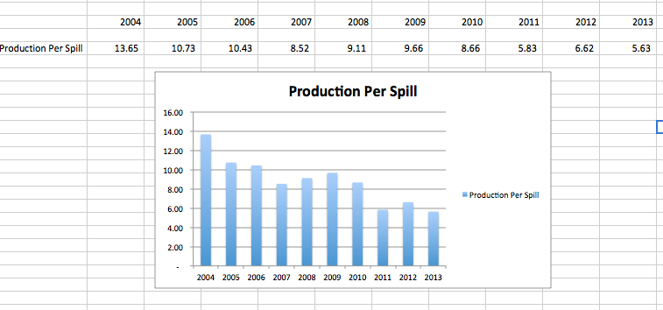
Behind The Boom
Robert Gebeloff -- @gebeloffnyt--NICAR 2015

Slide 74
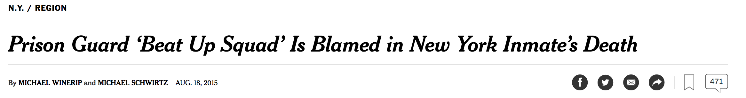
Race Behind Bars
Backstory: Rikers Island
.
NICAR Jacksonville, March 4 2017

Slide 75
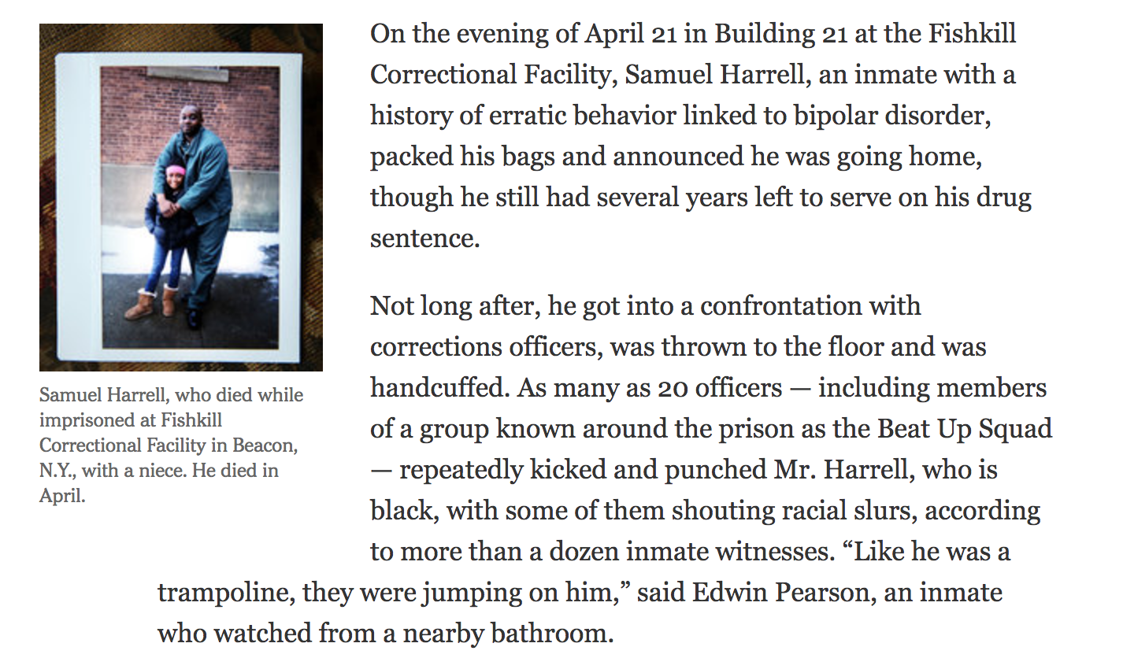
Race Behind Bars
.
NICAR Jacksonville, March 4 2017

Slide 76
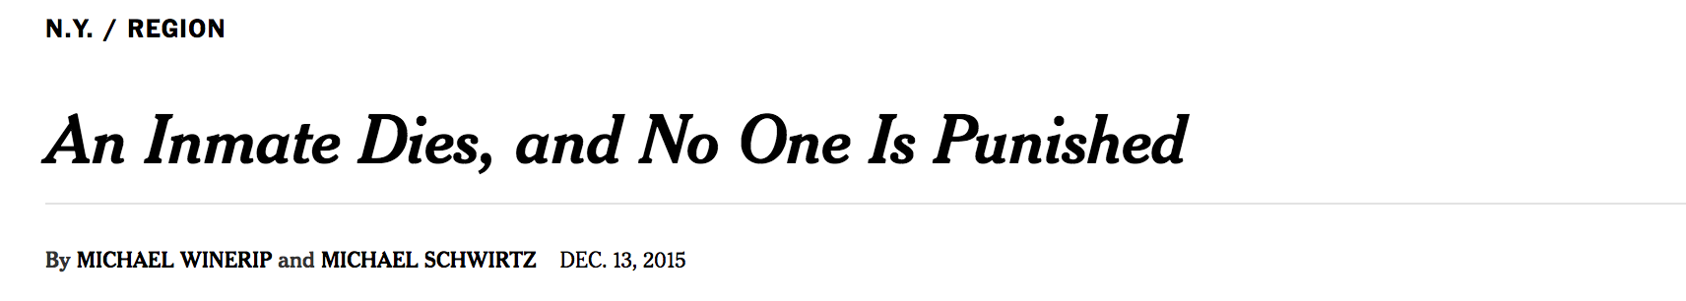
Race Behind Bars
.
NICAR Jacksonville, March 4 2017

Slide 77
Race Behind Bars
In a security video obtained by The New York Times, Mr. Strickland is seen in handcuffs, barely conscious and being dragged along the floor by officers, while a prison nurse standing close by does nothing. Even as he lies face down on the floor, near death, guards can be heard shouting, “Stop resisting.”
NICAR Jacksonville, March 4 2017

Slide 78
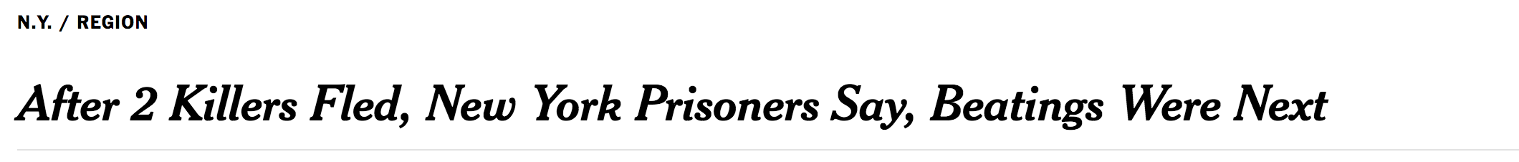
Race Behind Bars
NICAR Jacksonville, March 4 2017

Slide 79
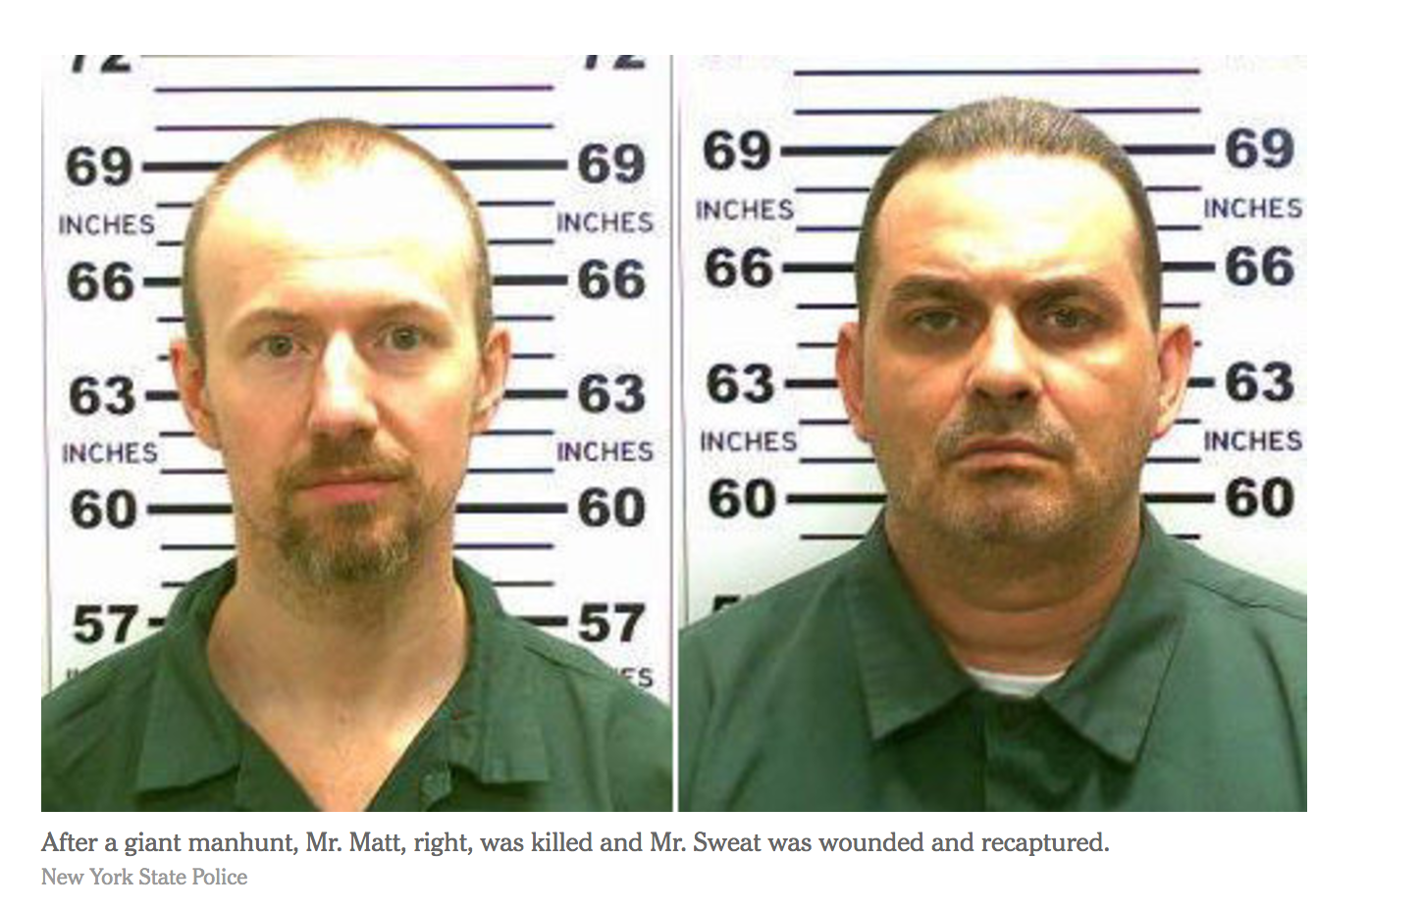
Race Behind Bars
.
NICAR Jacksonville, March 4 2017

Slide 80
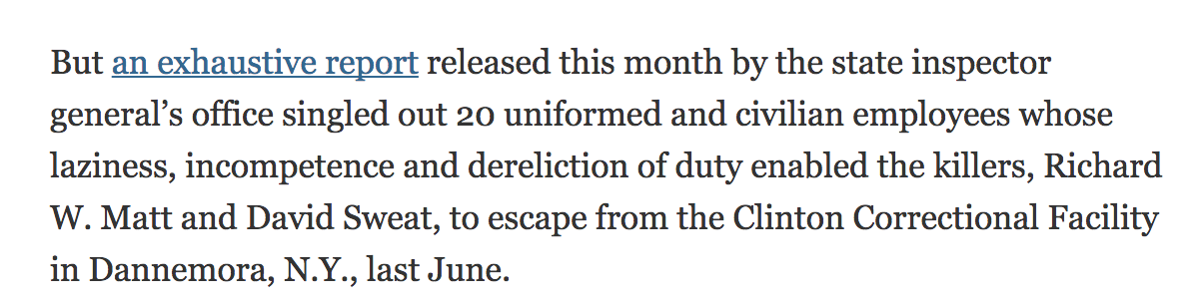
.
NICAR Jacksonville, March 4 2017

Slide 81
Race Behind Bars
State officials dismissed the brutality stories as isolated incidents. Gov. Andrew Cuomo said officers needed to be physical with inmates to “get a certain amount of respect in the job, otherwise, they get hurt.”
.
NICAR Jacksonville, March 4 2017

Slide 82
Race Behind Bars
Thus began quest to analyze racial bias more methodically, using data…
.
NICAR Jacksonville, March 4 2017

Slide 83
Race Behind Bars
Data acquired:
-- Master roster of past and present inmates
.
NICAR Jacksonville, March 4 2017

Slide 84
Race Behind Bars
Data acquired:
-- Master roster of past and present inmates
-- Database of inmate disciplinary punishments for 2015
.
NICAR Jacksonville, March 4 2017

Slide 85
Race Behind Bars
Data acquired:
-- Master roster of past and present inmates
-- Database of inmate disciplinary punishments for 2015
-- Three years of parole board decisions
.
NICAR Jacksonville, March 4 2017

Slide 86
Race Behind Bars
Data acquired:
-- Master roster of past and present inmates
-- Database of inmate disciplinary punishments for 2015
-- Three years of parole board decisions
-- Paper reports on hundreds of “assault on staff” incidents
.
NICAR Jacksonville, March 4 2017

Slide 87
Race Behind Bars
Data acquired:
-- Master roster of past and present inmates
-- Database of inmate disciplinary punishments for 2015
-- Three years of parole board decisions
-- Paper reports on hundreds of “assault on staff” incidents
-- Transcripts of more than 100 parole board hearings.
.
NICAR Jacksonville, March 4 2017

Slide 88
Race Behind Bars
Analytical approach:
Individual datasets good.
Joined datasets better.
.
NICAR Jacksonville, March 4 2017

Slide 89
Race Behind Bars
Analytical approach:
The disciplinary data did not contain any demographic characteristics of inmates. But we were able to join this data to the master roster of inmates, which included race, age, severity of the crime of conviction, etc.
.
NICAR Jacksonville, March 4 2017

Slide 90
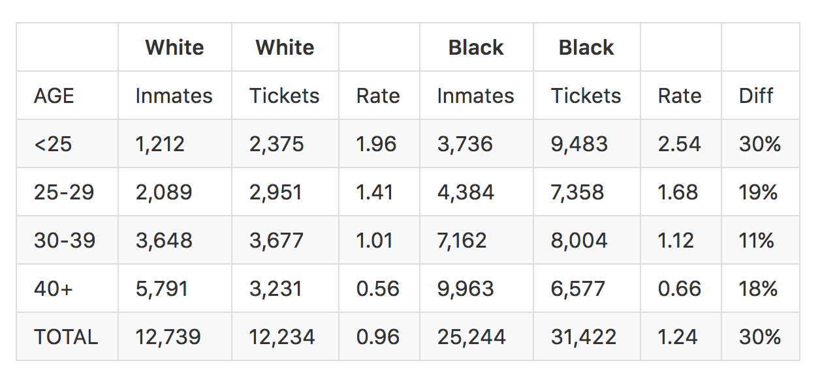
Race Behind Bars
.
NICAR Jacksonville, March 4 2017

Slide 91
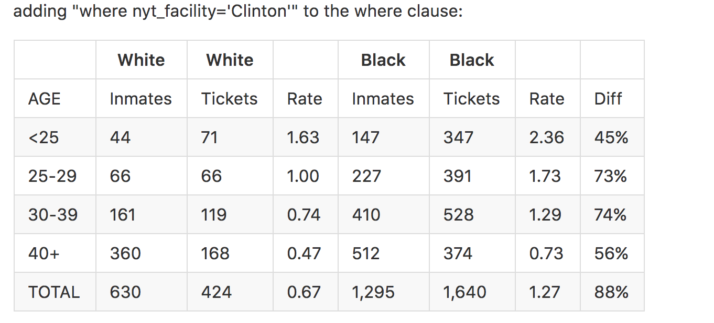
Race Behind Bars
.
NICAR Jacksonville, March 4 2017

Slide 92
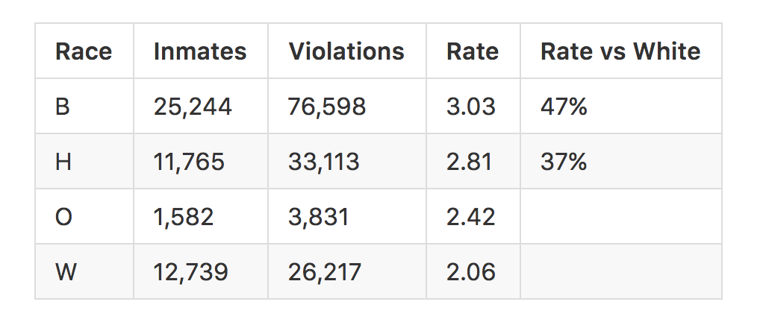
Race Behind Bars
.
NICAR Jacksonville, March 4 2017

Slide 93
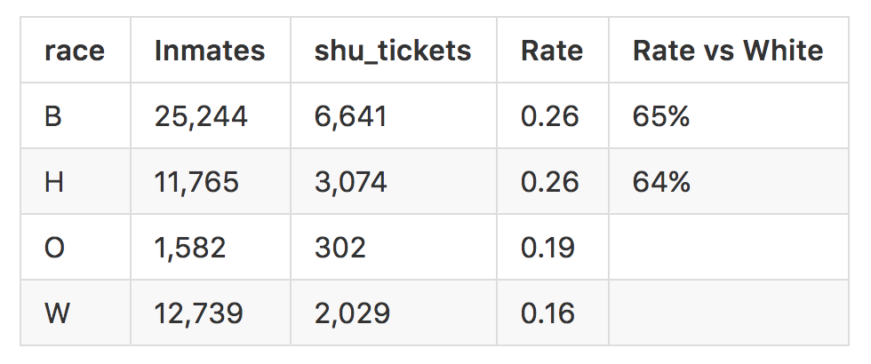
Race Behind Bars
.
NICAR Jacksonville, March 4 2017

Slide 94
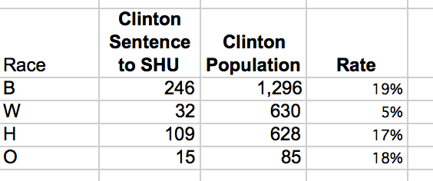
This table shows the racial distribution of inmates sentenced to solitary confinement at the Clinton Correctional Facility in 2015, compared to the overall inmate population.
NICAR Jacksonville, March 4 2017

Slide 95
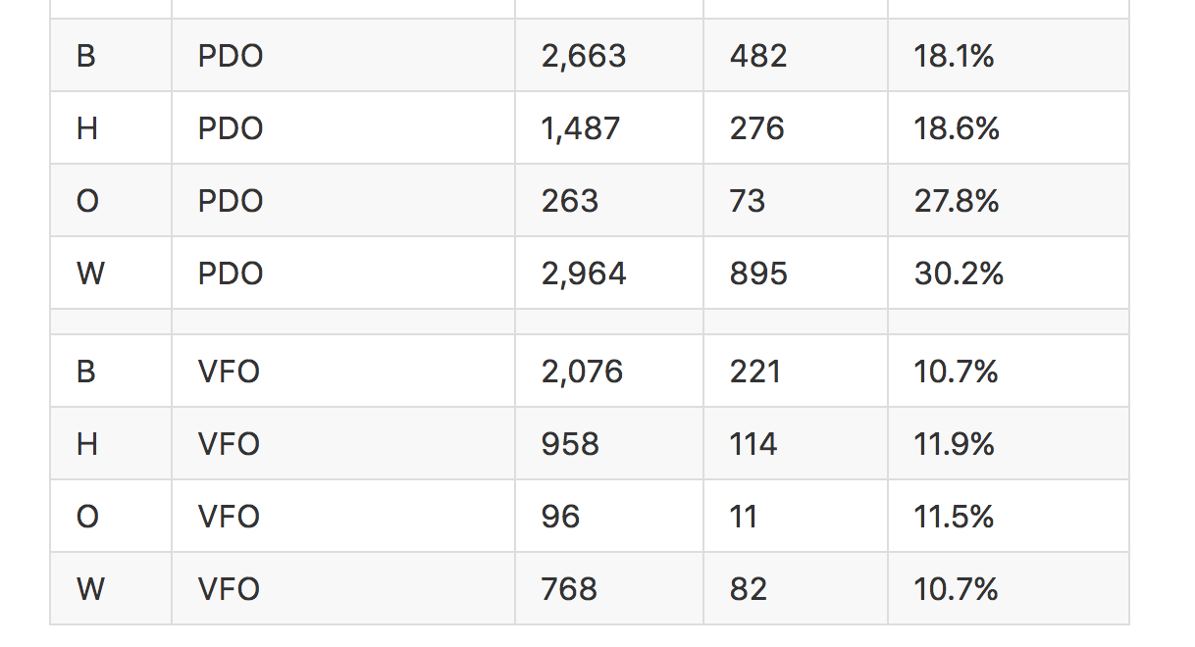
NICAR Jacksonville, March 4 2017

Slide 96
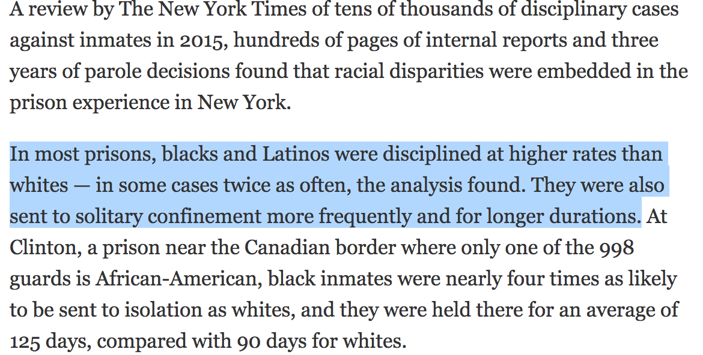
DISPARITY: WHAT IS IT AND HOW DO YOU MEASURE IT?
NICAR Jacksonville, March 4 2017

Slide 97
How Not to Be Wrong*
One last point before getting to some practical tips: Your target is often your best source. Share findings with experts, but also hostile experts. If there’s blowback, you want to know if before publication and INCLUDE the blowback in publication, not have it play out as a controversy AFTER publication.
Robert Gebeloff | @gebeloffnyt | Dataharvest 2017

Slide 98

How Not to Be Wrong*
Some Tips You Can Actually Use….
… as opposed to more blathering...
Robert Gebeloff | @gebeloffnyt | Dataharvest 2017

Slide 99
How Not to Be Wrong*
Make sure you know how many records you should have and that you have them all
Robert Gebeloff | @gebeloffnyt | Dataharvest 2017

Slide 100
How Not to Be Wrong*
Check your results against published totals
Robert Gebeloff | @gebeloffnyt | Dataharvest 2017

Slide 101
How Not to Be Wrong*
Consistency check your fields. Example: Are all company names spelled the same?
Robert Gebeloff | @gebeloffnyt | Dataharvest 2017

Slide 102
How Not to Be Wrong*
As you work, keep a data diary that records what you’ve done and how you’ve done it. (Ipython Notebook, or just plain notes)
Robert Gebeloff | @gebeloffnyt | Dataharvest 2017

Slide 103
How Not to Be Wrong*
As part of the proofing process, create a “footnotes” file – ID each fact, and document where it came from, how you know it, what’s the proof, what needs to be fixed…
Robert Gebeloff | @gebeloffnyt | Dataharvest 2017

Slide 104
How Not to Be Wrong*
Play offense – and defense – simultaneously. Go for the maximum possible story, but at all times, think of why you might be wrong, or what your target would say in response.
Robert Gebeloff | @gebeloffnyt | Dataharvest 2017

Slide 105
How Not to Be Wrong*
Check for duplicate records!
Robert Gebeloff | @gebeloffnyt | Dataharvest 2017

Slide 106
How Not to Be Wrong*
Check for duplicate records!
Robert Gebeloff | @gebeloffnyt | Dataharvest 2017

Slide 107
How Not to Be Wrong*
Check for duplicate records!
Robert Gebeloff | @gebeloffnyt | Dataharvest 2017

Slide 108
How Not to Be Wrong*
Pay attention to dates, in life and in data. Date data comes in many formats – often helps to split dates into year/month/day components to standardize them.
Robert Gebeloff | @gebeloffnyt | Dataharvest 2017

Slide 109
How Not to Be Wrong*
Identify and account for outliers. If most values are between 1,000 and 5,000, can you account for 40,000? Is it a mistake?
Robert Gebeloff | @gebeloffnyt | Dataharvest 2017

Slide 110
How Not to Be Wrong*
65,536
Robert Gebeloff | @gebeloffnyt | Dataharvest 2017

Slide 111
How Not to Be Wrong*
Bad survey = Bad information. At the NYT, policy is to have in-house survey experts review surveys before we write about them, but polling experts in general are good sources to have.
Robert Gebeloff | @gebeloffnyt | Dataharvest 2017

Slide 112
How Not to Be Wrong*
Base Year Abuse: If something is a trend, it should be true in general, not just if you pick a certain base year. Longer time horizons are better. Combine years/rolling average to smooth out bumps.
Robert Gebeloff | @gebeloffnyt | Dataharvest 2017

Slide 113
How Not to Be Wrong*
Statistical Significance + News Judgement – significance alone is not news, and almost any difference based on a large sample will be significant.
Robert Gebeloff | @gebeloffnyt | Dataharvest 2017

Slide 114
How Not to Be Wrong*
Underlying records, Part I: If possible, get at least some of paper records upon which the data is source. You’ll get a better feel for how data jibes with reality.
Robert Gebeloff | @gebeloffnyt | Dataharvest 2017

Slide 115
How Not to Be Wrong*
Underlying records, Part II: Report out some of the cases in the paper records and get an even fuller understanding of the case and how your queries reflect reality.
Robert Gebeloff | @gebeloffnyt | Dataharvest 2017

Slide 116
How Not to Be Wrong*
More tips from: Jennifer LaFleur, Christopher Groskopf, and Sarah Cohen.
Robert Gebeloff | @gebeloffnyt | Dataharvest 2017

